Slide 1
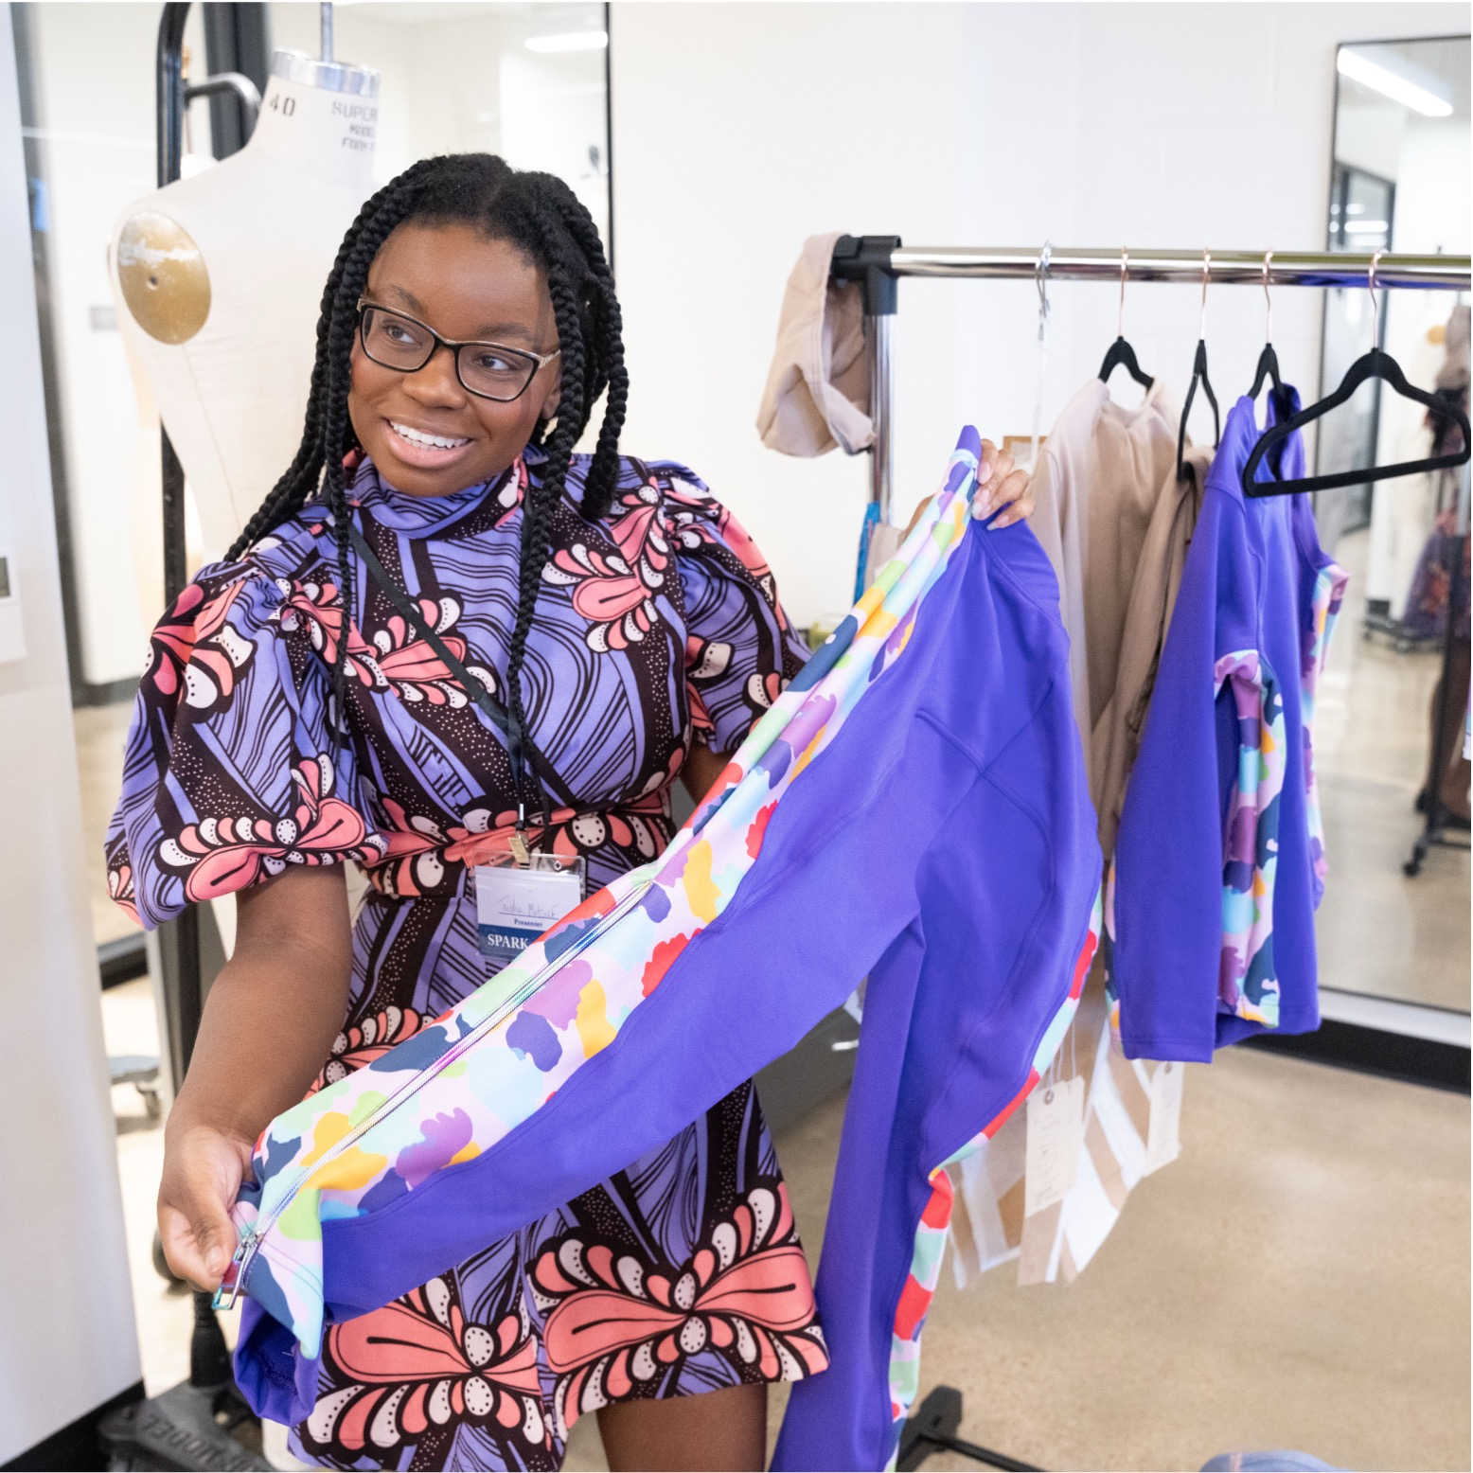

Watch Me
Present!
Session
Name
Time | Location
SPARK 2026
April 22nd

